Slide 1


Already presented at 2024 IEEE Vehicle Power and Propulsion Conference (IEEE VPPC2024), Washington DC, USA
Planning for electric-vehicle evacuations: energy, infrastructure, and storage needs
Farzan ZareAfifi, Ricardo de Castro, Sarah Kurtz
University of California Merced
Merced, Ca, 95343, USA

Slide 2
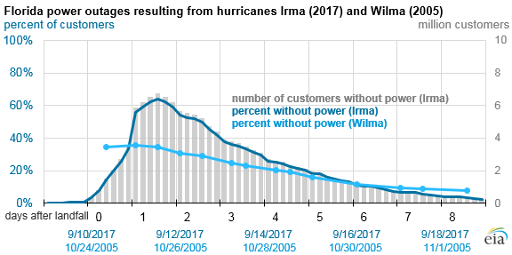
Motivation: Powering EVs for evacuations
Example of two hurricanes in Florida:
Power outage due to Hurricane Irma affected nearly two-thirds of Florida’s electricity customers¹.
90% of people used personal vehicles for evacuations due to Hurricane Irma².
Higher EV adoption requires reliable power solutions, especially during grid failures.
¹ https://www.eia.gov/todayinenergy/
² Wong et. al., 2018. Understanding evacuee behavior: a case study of hurricane Irma.

Slide 3
Overview of EV evacuation study
Motivation: Planning for powering EVs for evacuations
Part I: Energy needs
Strategy: Estimate energy needs for evacuation scenarios using a pragmatic stochastic method.
Results: Small evacuations (1,000 EVs) over an average distance of 100 km need MWh-level energy; large evacuations (1M EVs) need GWh-level over the same distance.
Part II: Charging infrastructure needs
Strategy: Assess power requirements of charging infrastructure, comparing with existing infrastructure in some California cities.
Results: Some California counties have sufficient chargers, but more chargers (especially fast chargers) are crucial for larger and faster evacuations.
Part III: Backup storage needs
Strategy: Determine backup lithium battery storage size for EV evacuations during grid failure.
Results: Truck-size backup lithium batteries for small evacuations; football field-size for large ones.

Slide 4
Part I: Energy needs
How much energy does an EV need to evacuate from a danger zone to a safe area?

Slide 5
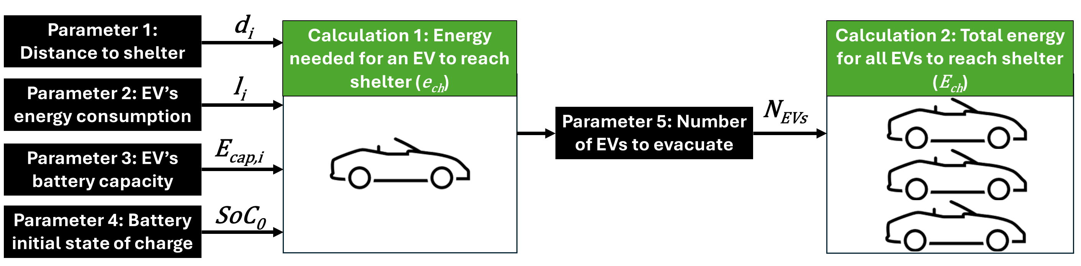

Part I: Method to estimate energy needs
We treat the parameters as random variables with probabilistic distributions to account for uncertainties.
Mathematical Overview (detailed in the paper):
Energy required to evacuate per vehicle: $e_{i}=l_{i}d_{i}$
Charging energy per vehicle: $e_{ch,i}=\max\left(e_{i}−SoC_{0}×E_{cap,i},0\right)$
Total charging energy for all EVs:${ E}_{ch}=\sum_{i=1}^{N_{EV}}{e_{ch,i}}$

Slide 6
Part I: Method to estimate energy needs
We treat the parameters as random variables with probabilistic distributions to account for uncertainties.
Parameter 1: Distance to shelter, modeled using a triangular distribution $Τ_{d} \left(d_{min},d_{mode}, d_{max}\right)$
Example:

Slide 7
Part I: Method to estimate energy needs
We treat the parameters as random variables with probabilistic distributions to account for uncertainties.
Parameter 2: Energy consumption ($l_{i}$), fitted to a Gaussian distribution based on a histogram of 360 EVs currently on the market¹:
Mean energy consumption: $μ_{l}$=0.188 kWh/km; standard deviation: $σ_{l}$= 0.025 kWh/km
¹ https://ev-database.org

Slide 8
Part I: Method to estimate energy needs
We treat the parameters as random variables with probabilistic distributions to account for uncertainties.
Parameter 3: Energy capacity ($E_{cap,i}$), also fitted to a Gaussian distribution from the same 360 EV dataset.
Mean energy capacity: $μ_{l}$=74.7 kWh; standard deviation: $σ_{l}$= 20.8 kWh

Slide 9
Part I: Method to estimate energy needs
We treat the parameters as random variables with probabilistic distributions to account for uncertainties.
Parameter 4: Initial state of charge (${SoC}_{0}$), modeled using a triangular distribution
$SoC_{0}\sim Τ_{SoC0} ({SoC}_{0,min},{SoC}_{0,mode}, {SoC}_{0,max})$:
Pessimistic scenario: ${SoC}_{0,mode}=0.1$; Average scenario: ${SoC}_{0,mode}=0.5;$Optimistic scenario: ${SoC}_{0,mode}=0.9$

Slide 10
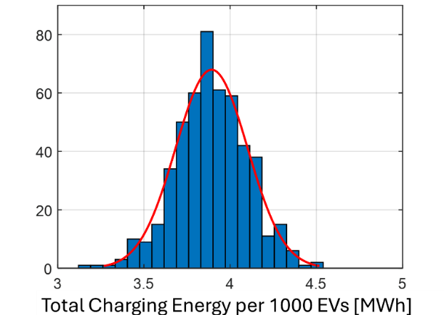

Part I: Energy needs results
We use a Monte Carlo simulation, sampling random variables from the probabilistic distributions, to estimate the total charging energy:
Example: the result for $d_{mode}=150 km$, an average initial SoC ${(SoC}_{0,mode}=0.5)$ and $N_{EV}=1000$:
Frequency
The histogram of $E_{ch}$ closely follows a Gaussian curve. We denote the mean of this Gaussian approximation as ${\hat{E}}_{ch}$.

Slide 11
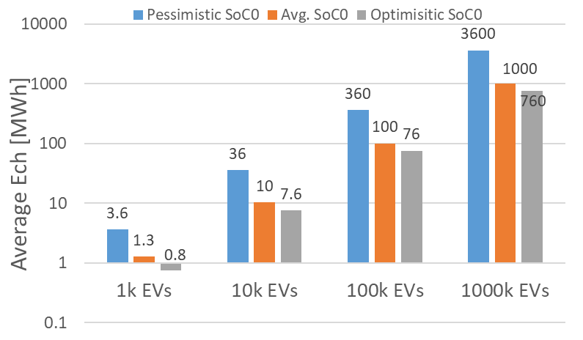
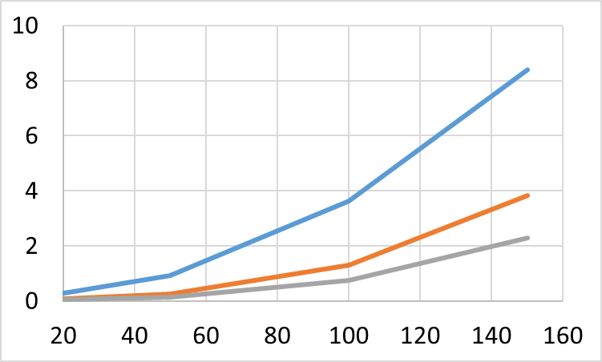




Part I: Energy needs results
${\hat{E}}_{ch}$ for different evacuation distances, SoC₀, and N_{EVs}:
$$d_{mode}=100 km$$
Pessimistic SoC0
${\hat{E}}_{ch}$ per 1000 EVs [MWh]
Average SoC0
${\hat{E}}_{ch}$ [MWh]
Optimistic SoC0
$Distance$[km]
Evacuating a small neighborhood with 1,000 EVs over an average distance of 100 km requires MWh-level energy, whereas a larger city with 1 million cars typically needs GWh-level energy.

Slide 12
Part II: Charging infrastructure needs
How many Level 2 and fast chargers are needed to meet the power requirements for a specific evacuation scenario?

Slide 13
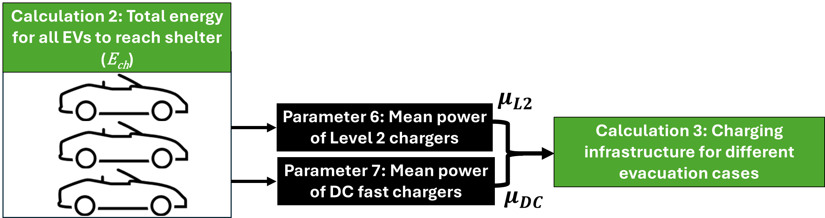


Part II: Method to estimate charging infrastructure needs
The power capability of each individual charger is assumed to have a Gaussian distribution:
Mean power of level-2 chargers: $μ_{l2}$=6 kW; standard deviation: $σ_{l2}$= 3 kW
Mean power of DC fast chargers: $μ_{DC}$=80 kW; standard deviation: $σ_{DC}$= 20 kW
Mathematical Overview (detailed in the paper):
$$p_{CH}^{∗}=\frac{E_{ch}^{∗} }{T_{eva}}$$
Charging energy needed
The average charging power needed
Evacuation time
Set of all feasible combinations of Level 2 and DC fast charging stations that can fulfill $p_{CH}^{∗}$ with >50% probability
$\hat{Γ}( p_{CH}^{∗})=\{\left(n_{L2},n_{DC}\right): {n_{DC}μ}_{DC}+n_{L2}μ_{L2}≥p_{CH}^{∗}\}$

Slide 14
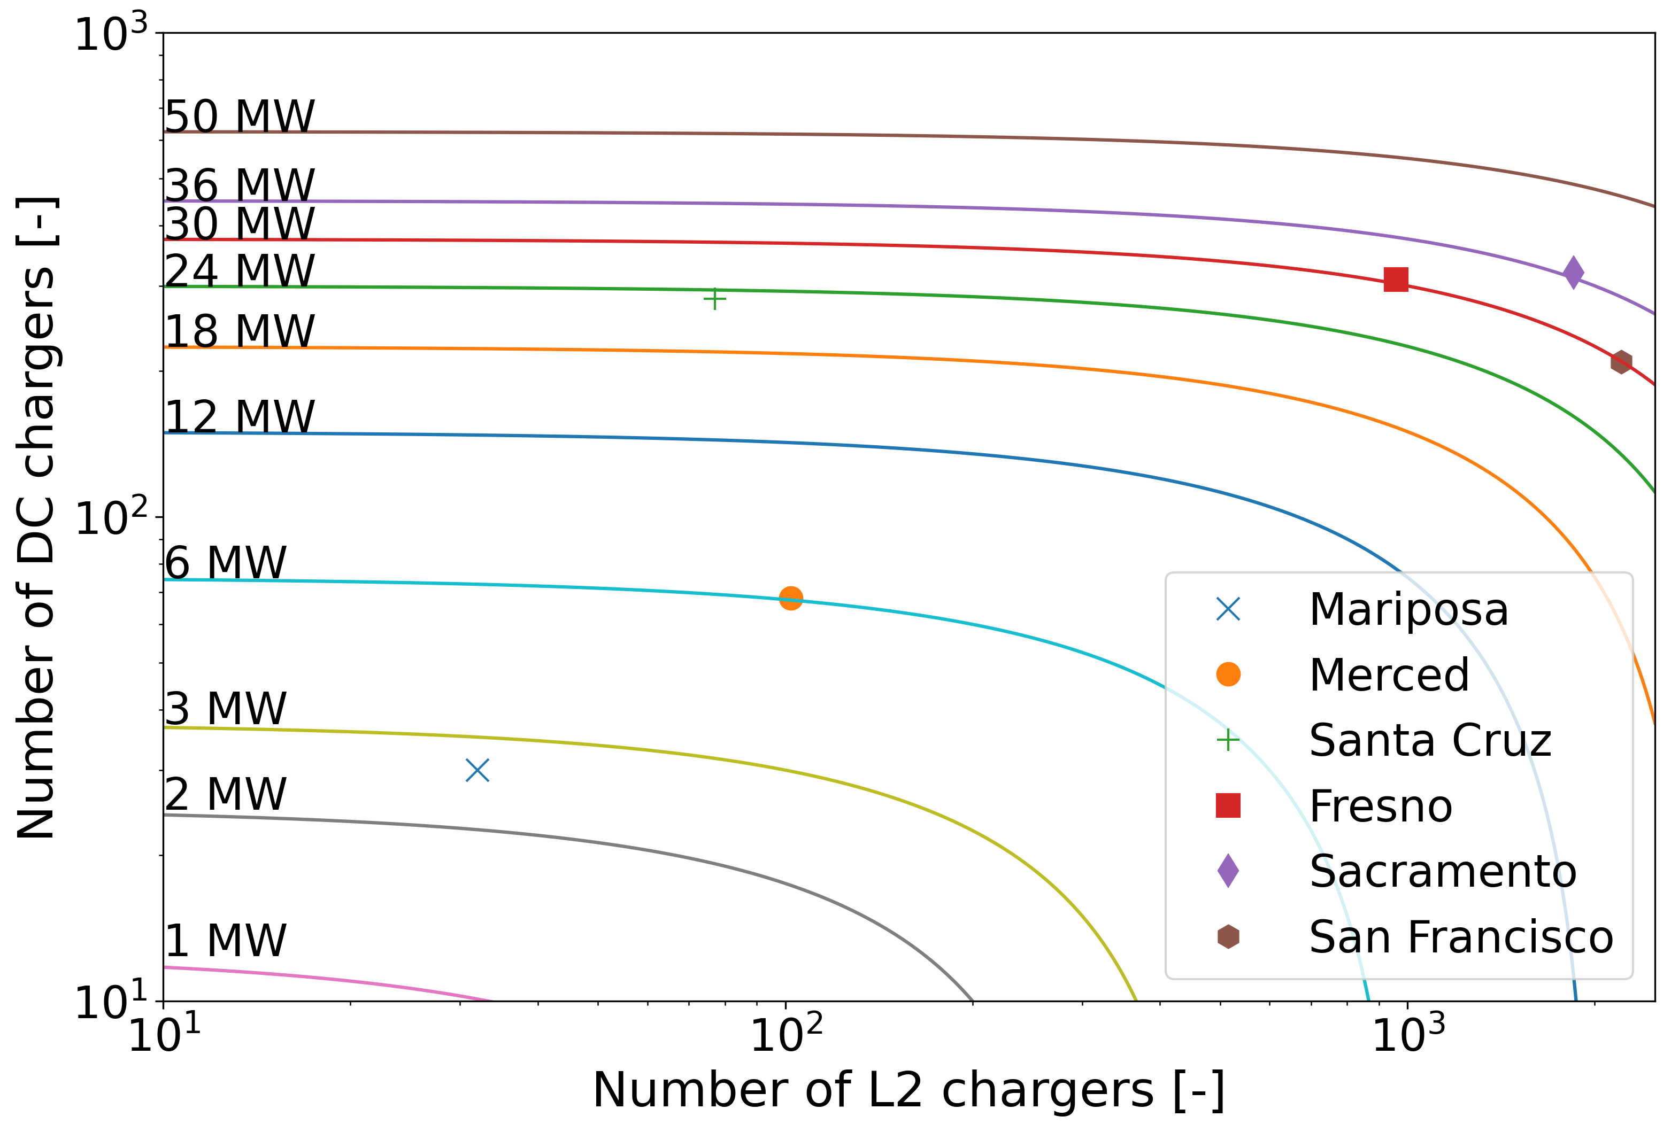
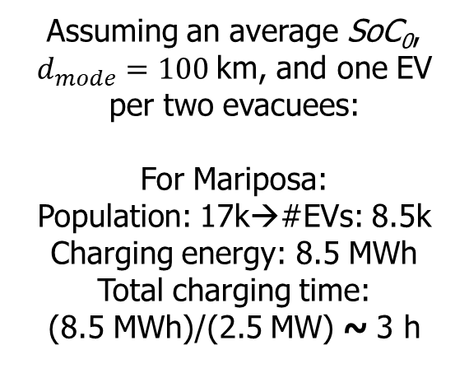
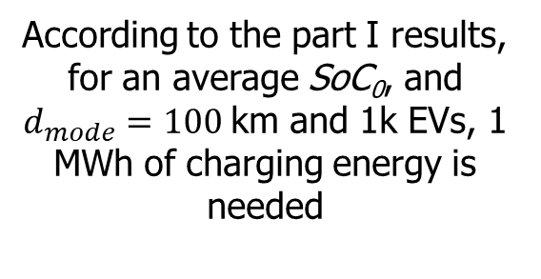
Part II: Charging infrastructure needs results
Boundary of $\hat{Γ}(p_{CH}^{∗})$ for different charging power requirements $p_{CH}^{∗}$:
Assuming an average SoC₀, $d_{mode}=100$km, and one EV per two evacuees:
For Mariposa:
Population: 17k→#EVs: 8.5k
Charging energy: 8.5 MWh
Total charging time:
(8.5 MWh)/(2.5 MW) ~ 3 h
Sacramento
According to the part I results, for an average SoC₀, and $d_{mode}=100$km and 1k EVs, 1 MWh of charging energy is needed
+
Santa Cruz
Fresno
San Francisco
Merced
Mariposa
For Sacramento:
Population: 1.5M→#EVs: 750k
Charging energy: 750 MWh
Total charging time:
(750 MWh)/(36 MW) ~ 21 h
This result suggests that some of California’s major cities, such as Sacramento, are underprepared for a large-scale EV evacuation with a short time window.

Slide 15
Part III: Backup lithium battery needs
How much land is required for backup lithium batteries to support EV evacuations during a grid failure?

Slide 16
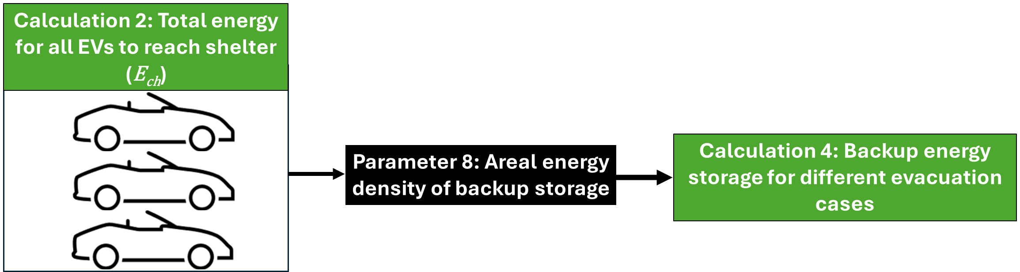
Part III: Method to estimate backup storage size
We use the areal energy density of commercially available lithium battery storage systems to determine the size of the backup storage:
Based on available market products, the areal energy density for lithium batteries is 160-570 (kWh/m2)^{1,2}.
¹ TESLA Mega Pack ² LG Energy Storage Systems

Slide 17
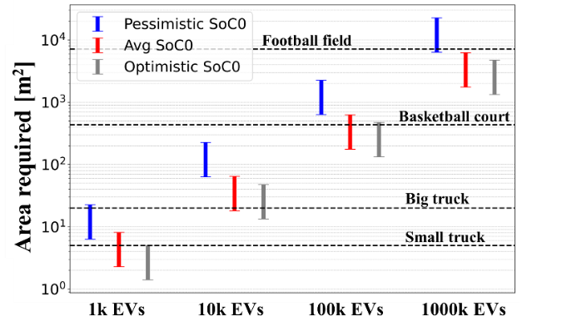

Part III: Backup storage size results
Size of backup lithium battery storage versus the scale of the evacuation:
$$d_{mode}=100 km$$
Assumption: No empty space between the storage products
Evacuating a small neighborhood with 1,000 EVs over a distance of 100 km could require a storage system small enough to be trucked in. However, larger evacuations, such as 1 million EVs over the same distance, may need storage the size of a football field.

Slide 18
Takeaways
Small evacuations (1,000 EVs) over 100 km require MWh-level energy, while large evacuations (1M EVs) over the same distance need GWh-level energy.
Many major California cities require additional chargers, particularly fast chargers, to handle evacuations within a short time window.
In the event of grid failure, a truck-sized backup lithium battery system is sufficient for small evacuations (1,000 EVs), but a football-field-sized system is needed for larger evacuations (1M EVs) over 100 km.

Slide 19
ACKNOWLEDGMENT
This research was supported by funds from the California Climate Action Seed Grants of the University of California.

Slide 20

Thank you for your attention!
I will be happy to answer questions.
https://crovosports.com/vikings-zoom-meeting-expectations-and-parent-q-a/

